Slide 1


Slide 2


Slide 3


Slide 4
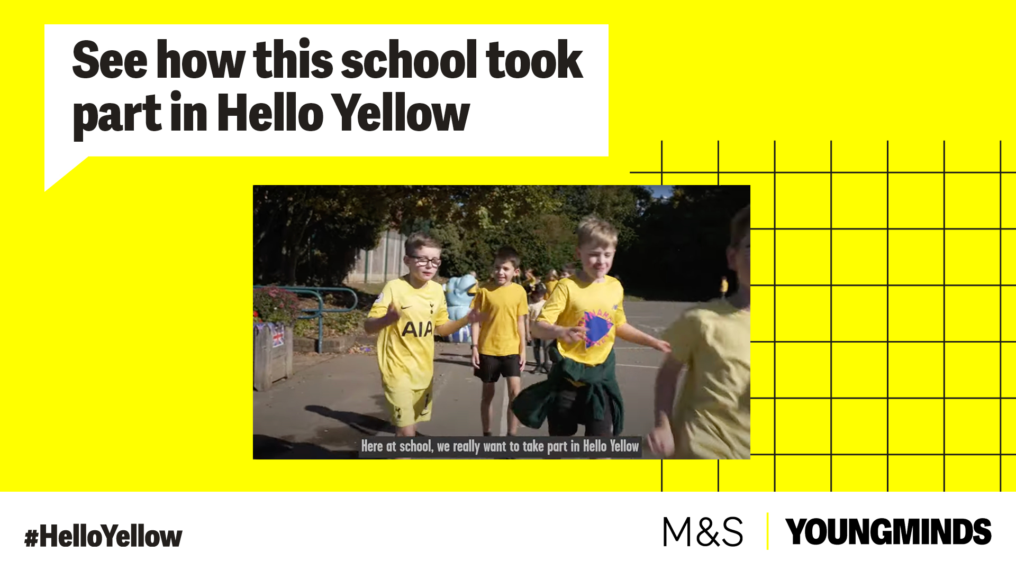

How can SJL help?

Slide 5



Slide 6



