Slide 1
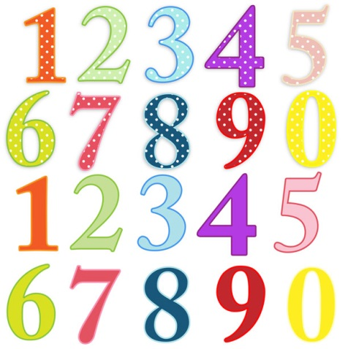


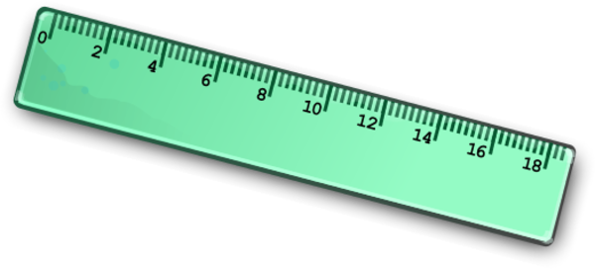

Maths at
Sir John Lillie Primary
Lee Duffy
Zoe Haynes & Bouchra Benharch

Slide 2
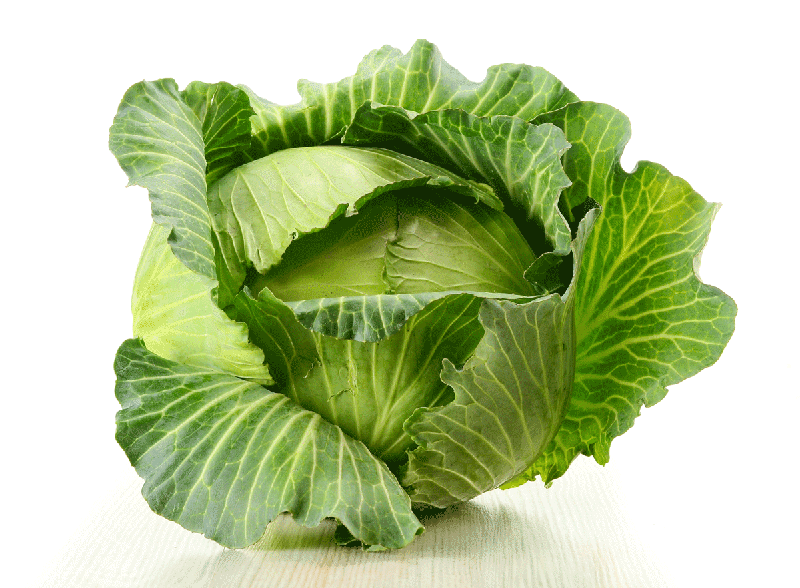
We must learn to love cabbage!

Slide 3
Key aspects
National Curriculum
Number
Number and place value
Addition and subtraction
Multiplication and division
Fractions, decimals and percentages
Measures
Geometry
Statistics

Slide 4


Slide 5

Aims of Curriculum
Majority of pupils to move through the programmes of study at broadly the same pace.
Keep up sessions – built in to support
Consolidation, through additional practice
More able – depth rather than breadth

Slide 6


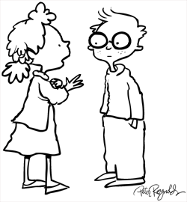
Fluency & Reasoning
Children are secure in their knowledge and can ASK (Apply their Skills and Knowledge)
Confident children who have deep understanding of the processes and can articulate this.

Slide 7
True or False
2, 5, 7, 9
All of these numbers are even.
Explain how you know?

Slide 8

Use of knowledge…
0, 2, 4, 6, 8
We know are all even numbers…
So what about 2.7?

Slide 9
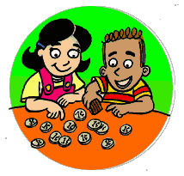
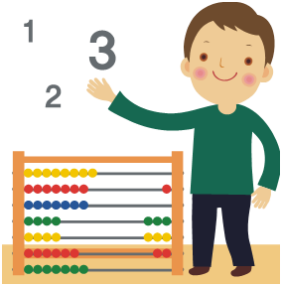

Counting!! So important – often overlooked!
Year 1 - count to and across 100, forwards and backwards, beginning with 0 or 1, or from any given number
Year 2 - count in steps of 2, 3, and 5 from 0, and in tens from any number, forward and backward
Year 3 - count from 0 in multiples of 4, 8, 50 and 100; find 10 or 100 more or less than a given number
Year 4 - count in multiples of 6, 7, 9, 25 and 1000
Year 5 - count forwards or backwards in steps of powers of 10 for any given number up to 1 000 000
Year 6 - read, write, order and compare numbers up
to 10 000 000 and determine the value of each digit

Slide 10
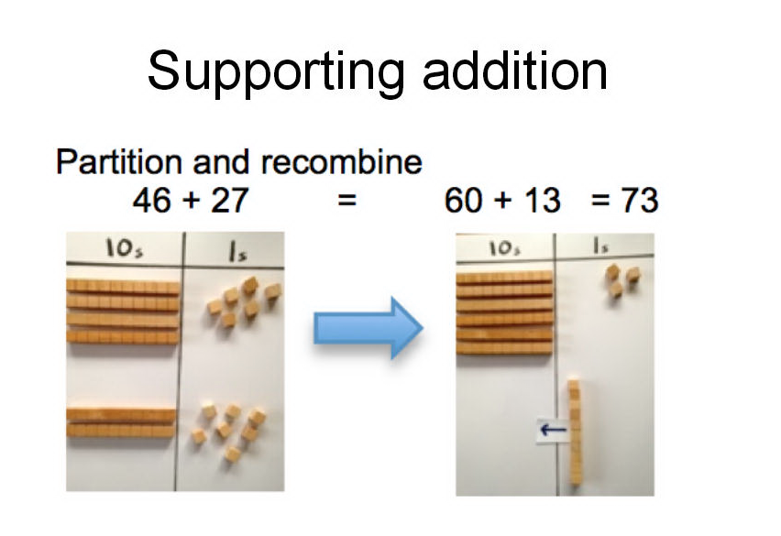

Slide 11
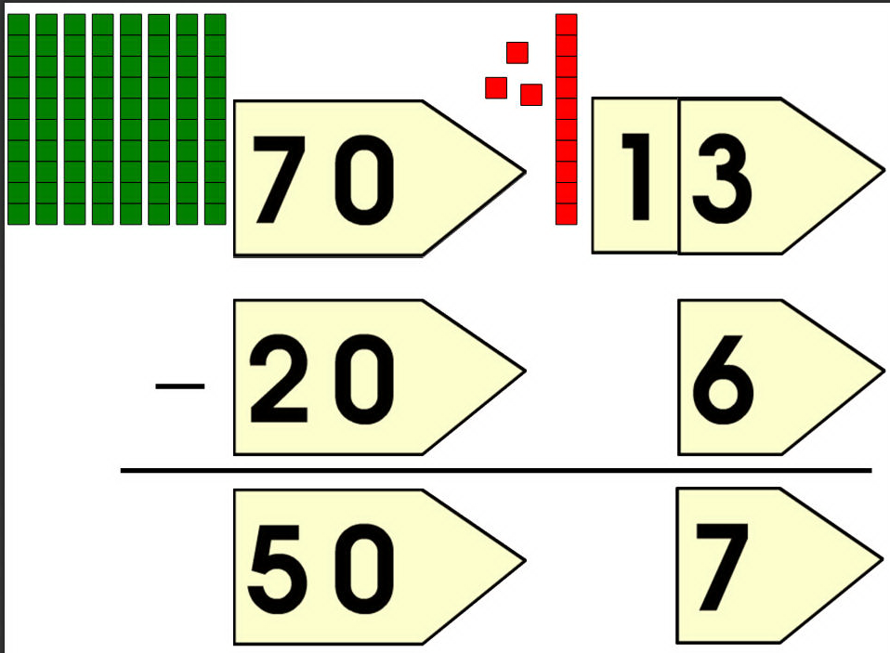

Slide 12


